Slide 1
DHP-600AV / DHP-601AV
Powerline AV2 Gigabit Adapter Powerline AV2 Starter Kit
Sales Guide
WRPD, Mar 2013
D-Link Confidential

Slide 2

Product Position
Just Plug & Play, No Configuration Required
No configuration required, just connect your PC to a DHP-600AV Powerline Adapter and plug it into a power outlet and instantly transform your household power grid into a fully functional network.
No New Wires
Turn any electrical power outlet into an Ethernet network connection using existing wires.
Advanced Multimedia Streaming
High speed data transfer rate up to 600Mbps, enables streaming media, high-speed Internet, on-line gaming, VoIP and DVD-quality video.

Slide 3

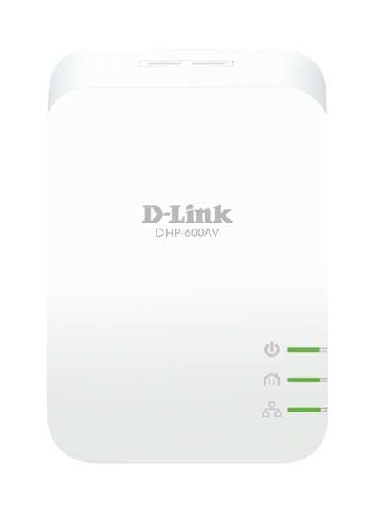





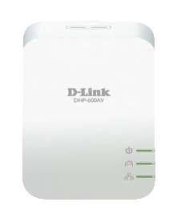
Brief Specification
AV2
High-speed data transfer rates
Up to 600Mbps
Simple Connect Button
for easy secure connection
Compact Design
Size decrease 20%
Reduce Power Consumption
Up to 55%

Slide 4
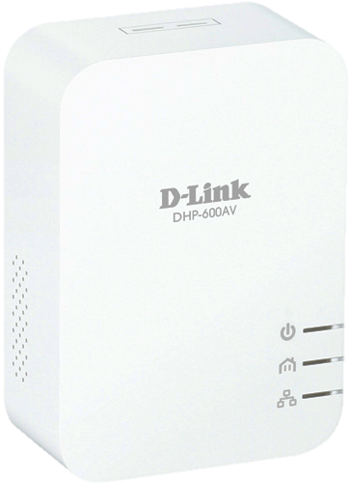
HomePlug AV2 specification
Speed up to 600Mbps.

Slide 5
Ultrafast Performance
UP to 20% Performance Enhancement.
Powerline
AV 500
Powerline
AV2

Slide 6
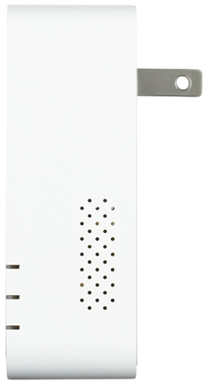
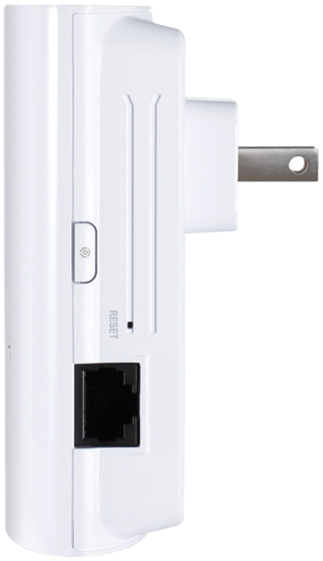
DHP-600AV
30 mm
Compact Design
Size decrease 20%.
87.47 mm
100 mm
DHP-500AV
34 mm

Slide 7
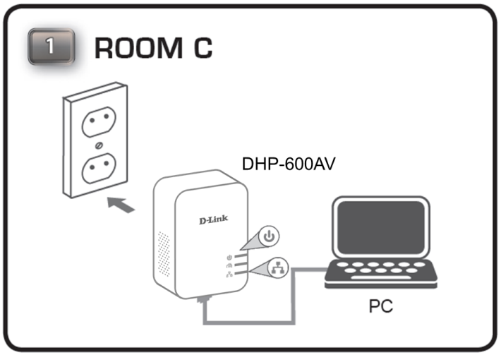
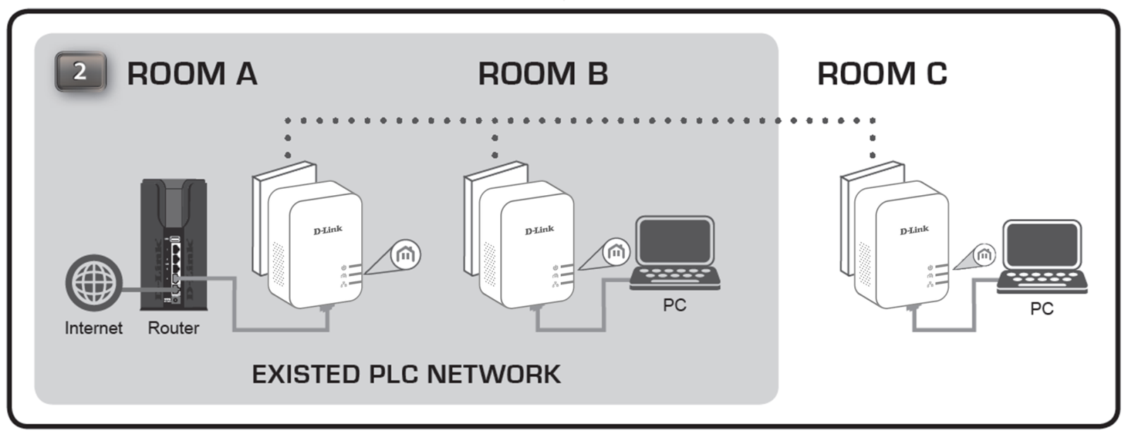
User Scenario

Slide 8
Safe Harbor Statement
The following is intended to outline our general product direction. It is intended for information purposes only, and may not be incorporated into any contract. It is not a commitment to deliver any material, code, or functionality, and should not be relied upon in making purchasing decisions. The development, release, and timing of features or functionality described for D-Link products remains at the sole discretion of D-Link.
Unpublished Work of D-Link Corp. All Rights Reserved.
This work is an unpublished work and contains confidential, proprietary, and trade secret information of D-Link Corp. Access to this work is restricted to D-Link employees who have a need to know to perform tasks within the scope of their assignments. No part of this work may be practiced, performed, copied, distributed, revised, modified, translated, abridged, condensed, expanded, collected, or adapted without the prior written consent of D-Link Corp. Any use or exploitation of this work without authorization could subject the perpetrator to criminal and civil liability.
General Disclaimer
This document is not to be construed as a promise by any participating company to develop, deliver, or market a product. D-Link Corp., makes no representations or warranties with respect to the contents of this document, and specifically disclaims any express or implied warranties of merchantability or fitness for any particular purpose. Further, D-Link Corp., reserves the right to revise this document and to make changes to its content, at any time, without obligation to notify any person or entity of such revisions or changes. All D-Link marks referenced in this presentation are trademarks or registered trademarks of D-Link Corp. in the Taiwan and other countries. All third-party trademarks and images are the property of their respective owners.

